Slide 1

Project Presentation
On
Common Mode Voltage reduction strategies of 2/3 level inverter
Visvesvaraya National Institute of Technology
Electrical Department

Slide 2
Presented By:
A. JITENDRA – BT19EEE001
MRUNAL SANDIP ATHAWALE – BT19EEE017
SANDEEP KUMAR SINGH – BT19EEE092
YASHASWIN VANNALA – BT19EEE110
PRESENTED TO:
Final Year Project Committee,
Department of Electrical and Electronic Engineering
PROJECT ADVICER:
Dr . NARENDRABABU A
ASSISTANT PROFESSOR
Visvesvaraya National Institute of Technology
Electrical Engineering Department

Slide 3
PRESENTATION FLOW:
Project objective
CMV in inverters
INTRODUCTION
Example of CMV in inverter
Problems caused by CMV in inverter driven AC machine
INVERTERS
Space vector modulation
Hybrid 2/3 level inverter
Future enhancements
Multilevel inverters
CMV reduction techniques
Visvesvaraya National Institute of Technology
Electrical Engineering Department

Slide 4
PROJECT OBJECTIVE
Reducing of common mode voltage and it’s effects in inverters by using space vector modulation technique
Visvesvaraya National Institute of Technology
Electrical Engineering Department

Slide 5
INTRODUCTION
The industry are focusing their efforts on finding more efficient and reliable electrical machines and motor drives.
However, many of the motors driven by pulse-width modulated converters face the recurring problem of common-mode voltage (CMV)
In fact, this voltage leads to other problems such as bearing breakdown, deterioration of the stator winding insulation and electromagnetic interferences (EMI) that can affect the lifespan and correct operation of the motors.
Visvesvaraya National Institute of Technology
Electrical Engineering Department

Slide 6
COMMON-MODE VOLTAGE IN INVERTER
Common-mode Voltage In a three-phase AC system, it can be defined as the voltage difference between the power source ground and the neutral point of a three-phase load.
If the load is an AC motor, the neutral point of the load means the stator neutral of the motor.
It is important to define the common-mode voltage in mathematical terms in order to compare its characteristics among different types of source and load combinations.
Visvesvaraya National Institute of Technology
Electrical Engineering Department

Slide 7
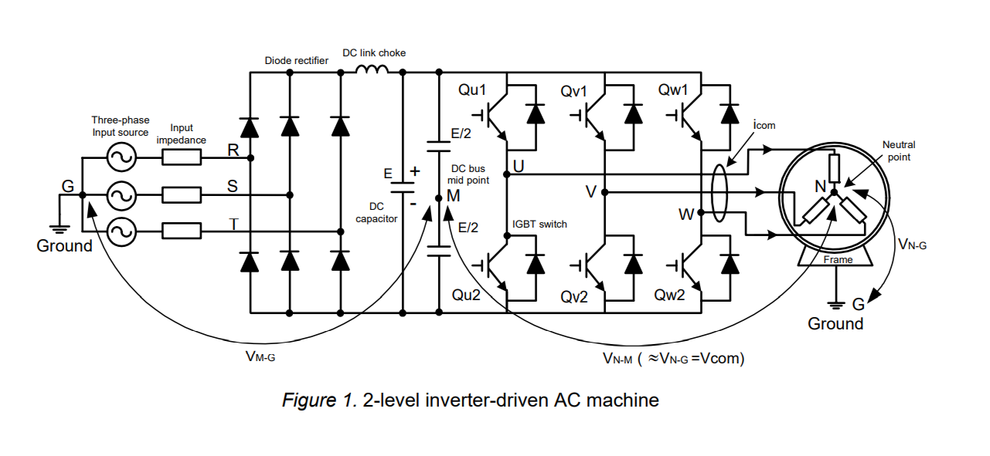
EXAMPLE OF CMV IN INVERTER-DRIVEN AC MACHINE:
Visvesvaraya National Institute of Technology
Electrical Engineering Department

Slide 8
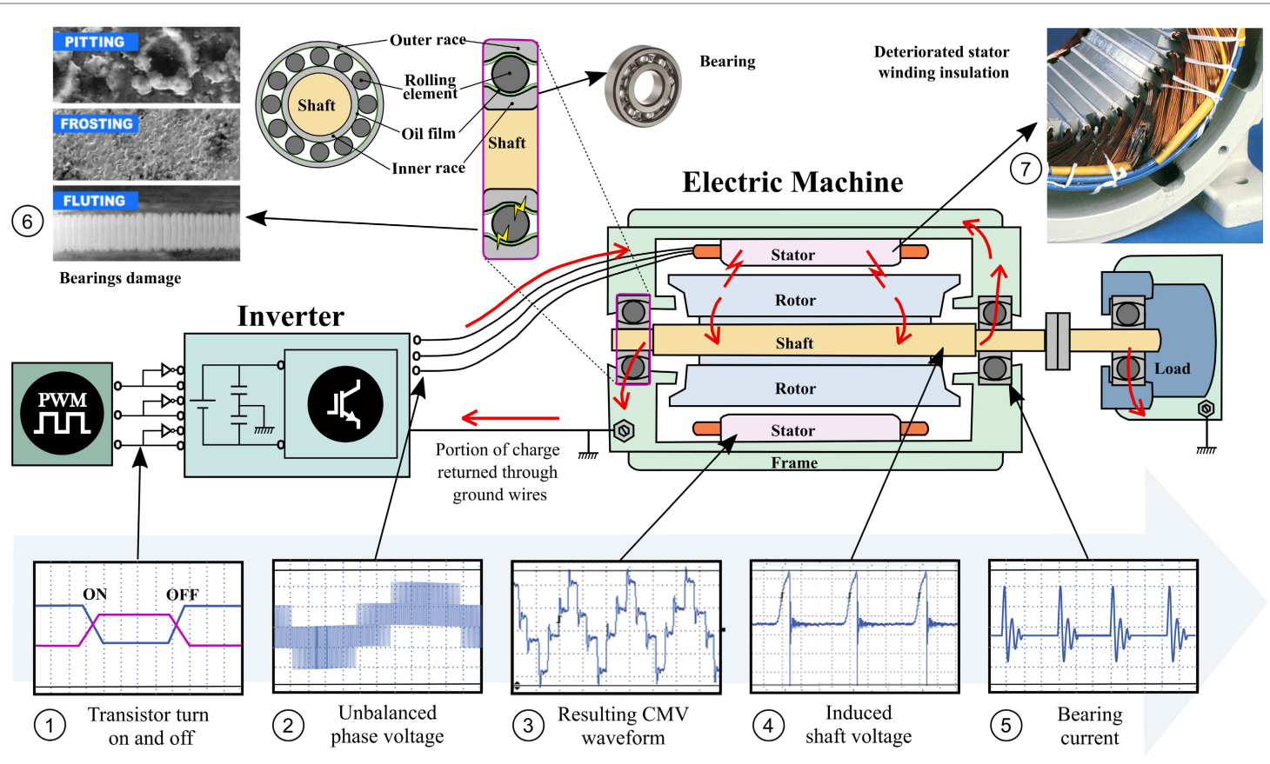
PROBLEMS CAUSED BY CMV IN INVERTERS:
Visvesvaraya National Institute of Technology
Electrical Engineering Department

Slide 9
TYPES OF INVERTERS USED IN INDUSTRIES
2-LEVEL INVERTER :
2-level voltage source inverters, there are eight different switching states for the six inverter-switches, and the voltages across the output terminals and the DC bus mid-point can be either +E/2 or -E/2 according to the inverter switching states
Visvesvaraya National Institute of Technology
Electrical Engineering Department

Slide 10
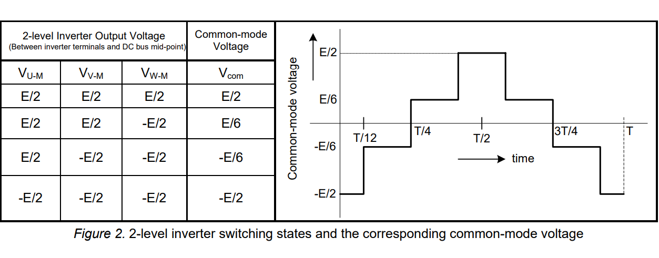
2 LEVEL INVERTER SWITCHING STATES AND CORRESPONDING CMV
Image shows the switching states and the common-mode voltage waveform.
During a PWM cycle, the change in voltage from -E/2 to -E/6 constitutes a change of E/3.
When the level changes from -E/6 to +E/6 the change in voltage is again E/3.
Visvesvaraya National Institute of Technology
Electrical Engineering Department

Slide 11
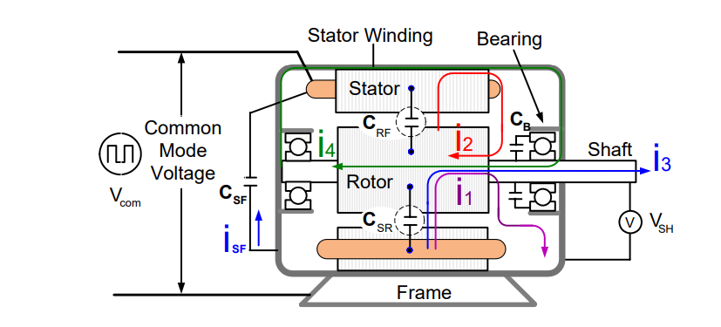
Since the motor windings are fed from PWM pulses having fast rising and falling common mode voltage edges, there exists a leakage current from each phase to ground due to the existence of various parasitic capacitances .
This leakage current flows only during the step change in the common mode voltage and is called common mode current.
Visvesvaraya National Institute of Technology
Electrical Engineering Department

Slide 12
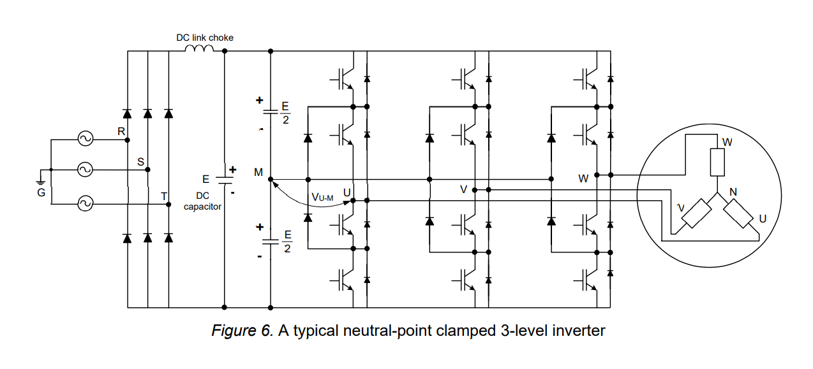
MULTILEVEL INVERTERS:
3 level inverters:
A 3-level inverter has four switches (IGBTs) per phase, totaling twelve switches (IGBTs) for all three phases.
According to the switching signals, each output phase voltage with respect to the DC bus mid-point can have three distinct levels, i.e. E/2, 0, and -E/2. Consequently, this arrangement is called a 3- level inverter.
Visvesvaraya National Institute of Technology
Electrical Engineering Department

Slide 13
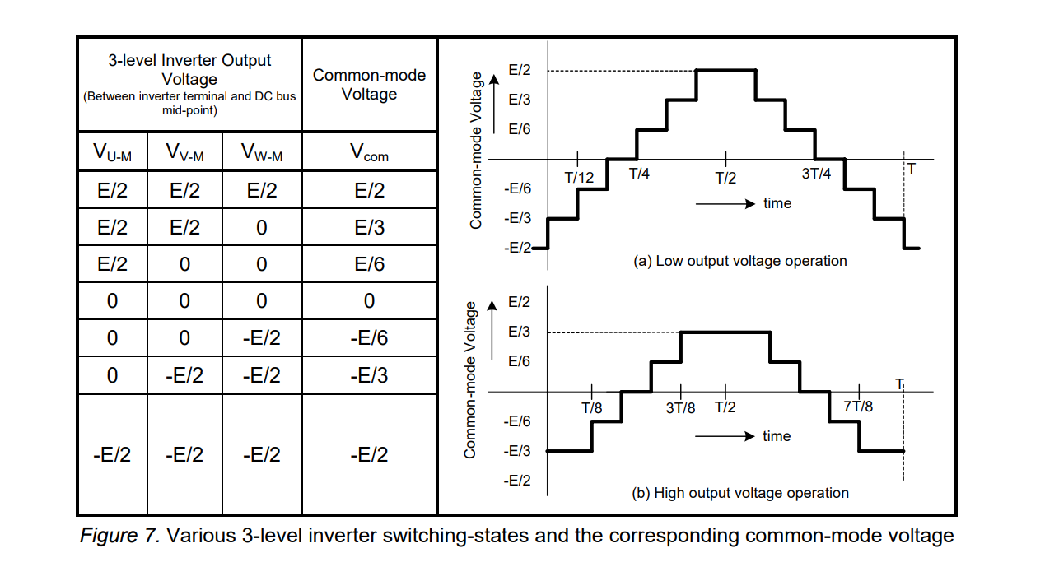
3 LEVEL INVERTER SWITCHING STATES AND CORRESPONDING CMV:
Visvesvaraya National Institute of Technology
Electrical Engineering Department

Slide 14
CON’S OF MULTILEVEL INVERTERS
Multilevel inverters work efficiently in reducing CMV for both low output voltage operation and for high output voltage operation.
Although they may be used in high voltage output operation in industries, for the low output voltage operation they cost heavily as there is a significant increase in switching devices and increased complexity.
Due to many switches multiple gate pulses must be generated, which again requires the use of advanced DSP’s which costs heavily for normal uses of inverters.
Visvesvaraya National Institute of Technology
Electrical Engineering Department

Slide 15
CMV REDUCTION TECHNIQUES:
SVM instead of conventional modulation techniques
The CMV is directly related to the converter output phase voltages. In general, incorporating additional hardware in these converters to improve the CMV is not interesting, because these architectures are already complex from the hardware point of view.
The most well-known multilevel converter structures are Neutral-point-clamped (NPC) , the Flying capacitor (FC) and the Cascaded H-bridge (CHB).
Topologies that include a clamping circuit in addition to the NPC, as the Active neutral-point clamped (ANPC) and the T-type NPC are also interesting options.
All these multilevel topologies can be used to reduce the CMV due to their additional degrees of freedom.
Thus, a better solution is to achieve the CMV reduction through advanced modulation algorithms. The relationship between the switching states of the power converter devices and the vector representation of an SV-based modulation helps to better understand CMV.
Visvesvaraya National Institute of Technology
Electrical Engineering Department

Slide 16
SPACE VECTOR MODULATION:
Space vector modulation (SVM) is one of the preferred real-time modulation techniques and is widely used for digital control of voltage source inverters.
This presents the principle and implementation of the space vector modulation for the two-level inverter.
It contains Six Sectors of Triangular in shape and each sector consists of different switching states.
The switching states decides the reduction in common mode voltage.
Visvesvaraya National Institute of Technology
Electrical Engineering Department

Slide 17
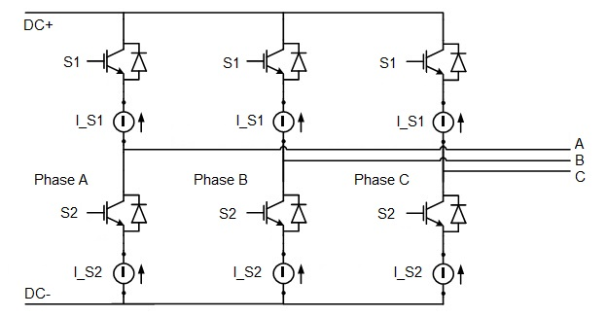
SPACE VECTOR MODULATION OF 2 LEVEL INVERTER:
3 PHASE 2 LEVEL INVERTER:
Visvesvaraya National Institute of Technology
Electrical Engineering Department

Slide 18
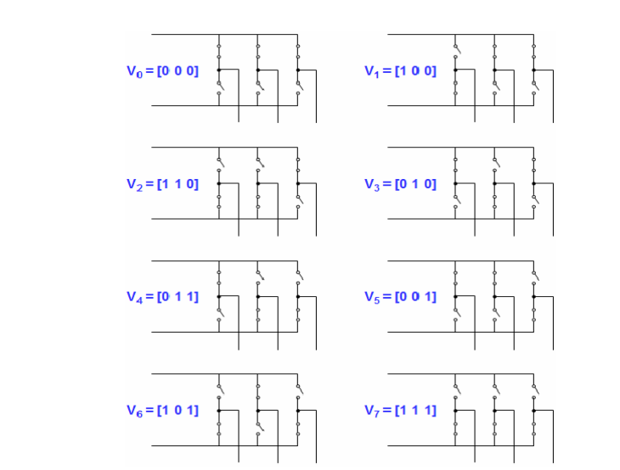
DIFFERENT SWITCHING STATES OF 2 LEVEL INVERTER
Visvesvaraya National Institute of Technology
Electrical Engineering Department

Slide 19
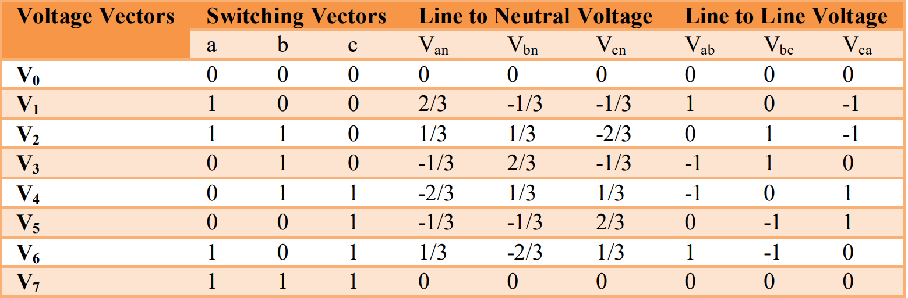
Eight switching states of a two level inverter:
Visvesvaraya National Institute of Technology
Electrical Engineering Department

Slide 20
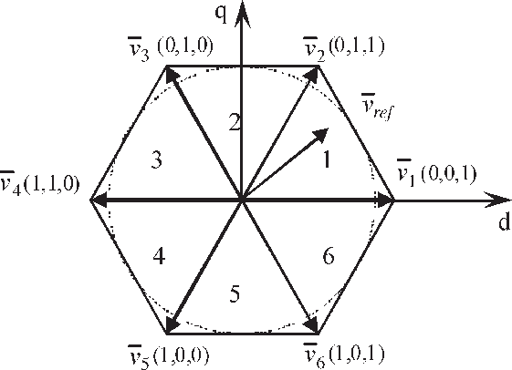
SPACE VECTOR OF 2 LEVEL INVERTER:
Visvesvaraya National Institute of Technology
Electrical Engineering Department

Slide 21
HYBRID 2/3 LEVEL INVERTER:
NEED OF NEW INVERTER ?
A new hybrid 2/3 level inverter, that combines features from both two- and three-level inverters with a reduced number of extra semiconductors.
It acts for a very wide modulation index this inverter can switch the maximum and the minimum phase voltages as a three level inverter ,while the third phase voltage is switched as a two level inverter.
Only for a very narrow band in the modulation index range this topology behaves as a two-level inverter.
Visvesvaraya National Institute of Technology
Electrical Engineering Department

Slide 22
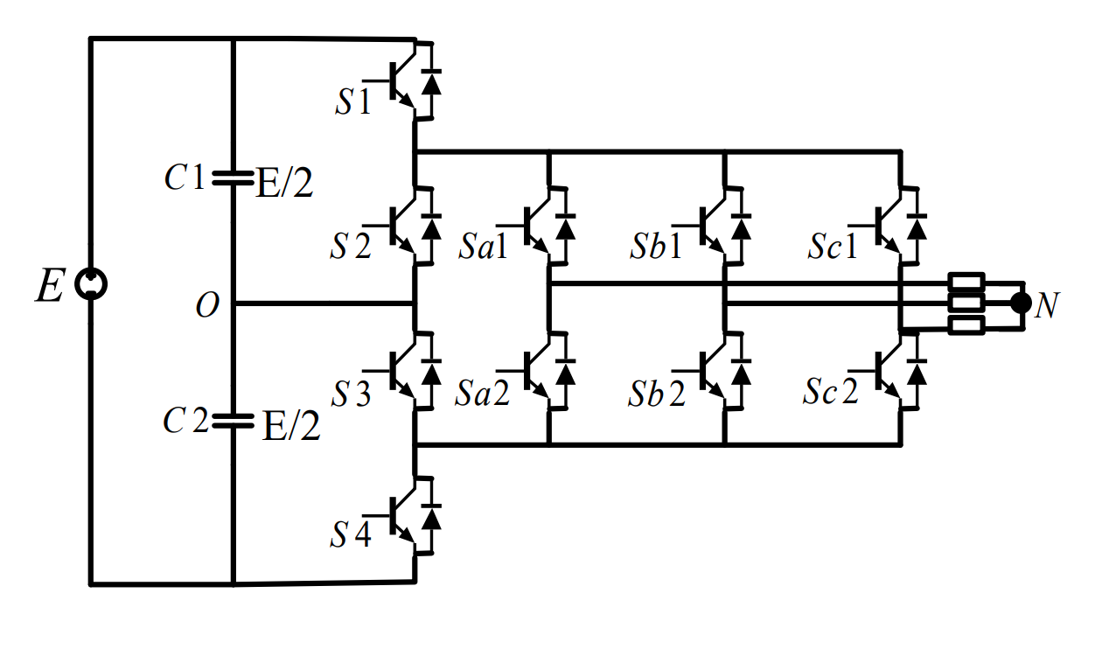
STRUCTURE OF 2/3 LEVEL INVERTER:
Visvesvaraya National Institute of Technology
Electrical Engineering Department

Slide 23
ADVANTAGES IF 2/3 LEVEL INVERTER OVER 2 LEVEL AND MULTILEVEL INVERTERS:
The new 2/3 level inverter is less complex and cost free.
The 2/3 level inverter is a best option for medium output voltage operations such as PV arrays etc.
The 2/3 level inverter wins over the typical 2 level inverter in its reduced CMV.
The configuration requires only ten controlled switches and can be easily developed by adding two half bridge modules to a two-level inverter
Visvesvaraya National Institute of Technology
Electrical Engineering Department

Slide 24
FUTURE ENHANCEMENT
Investigation of modulation strategies to improve output voltage and common mode performance simultaneously etc.
Applications like EV drive , AC DC charger using hybrid 2/3 level converter etc.
Visvesvaraya National Institute of Technology
Electrical Engineering Department

Slide 25
REFERENCES
www.Wikipedia.org
www.researchgate.net
https://ieeexplore.ieee.org/
https://www.switchcraft.org/
Research paper by Dr . Narendra babu A Department of Electrical and Electronics Engineering
Visvesvaraya National Institute of Technology
Electrical Engineering Department

Slide 26
A Special thanks to
Dr. NARENDRABABU A for Helping us to make this possible
Visvesvaraya National Institute of Technology
Electrical Engineering Department

